Slide 1

Designing and machine learning enhancement of a low-cost optical seismometer for detecting seismic activities.
Mid-Term Presentation by
Neeraj Joshi
MTech (Instrument technology)
Entry No. 2021JID2579
SeNSE, IIT Delhi
Under the supervision of
Prof. Manish Kumar
Associate Professor
SeNSE, IIT Delhi

Slide 2
Content
What is a Seismometer?
Introduction
Geophones used in existing seismometersGoals of your project work
Problem in the existing systems
Goals of your project work:
Compact Optical seismometer setup
Work completed to date and future execution plans

Slide 3
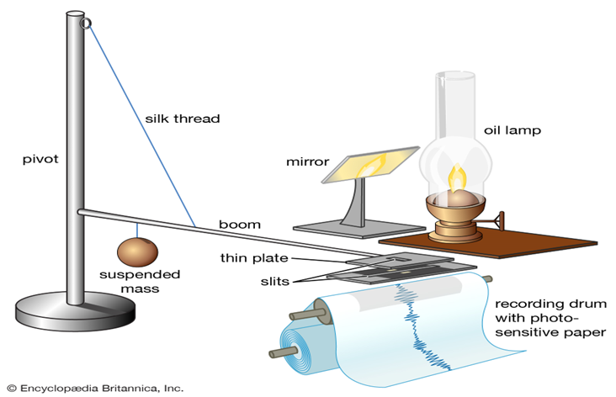
What is a Seismometer?
Seismometer, instrument that makes a record of seismic waves caused by an earthquake, explosion, or other earth-shaking phenomenon.
The first true seismograph, according to italian seismologists, was created in 1875 by italian physicist filippo cecchi.

Slide 4
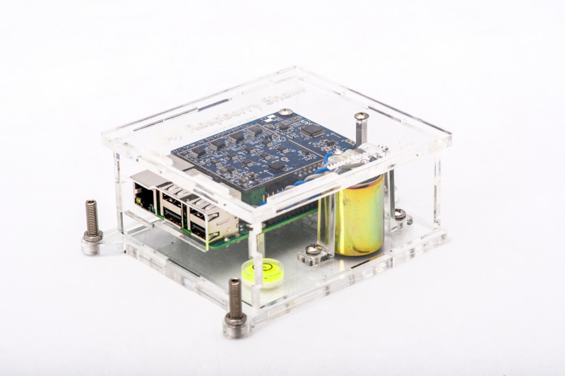
Introduction
Seismologists have recently begun using low‐cost nodal sensors in dense deployments to sample the seismic wavefield at unprecedented spatial resolution. Earthquake early warning systems and other monitoring networks would also benefit from network densification ; however, current nodal sensors lack power systems or the real‐time data transmission required for these applications.
A candidate sensor for these networks may instead be a low‐cost, all‐in‐one package such as the OSOP Raspberry Shake 4D (RS‐4D).
The RS‐4D includes a vertical‐component geophone, three‐component accelerometer, digitizer, and near‐real‐time miniSEED data transmission and costs only a few hundred dollars per unit.

Slide 5
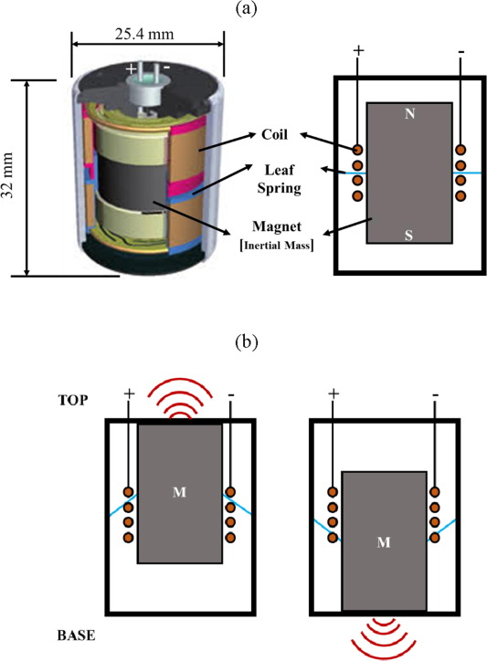
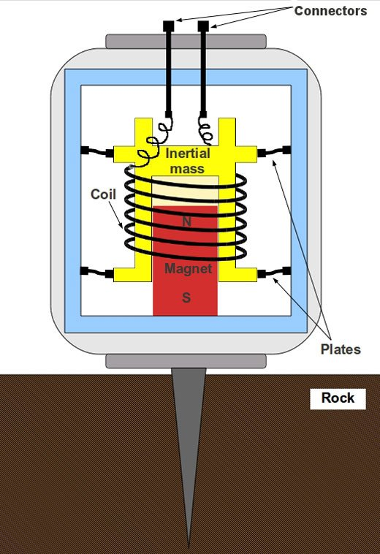
Geophones used in existing seismometers
Geophones are devices that generate electric signals proportional to the vibrations.
The case is rigidly attached to the earth . The mass mounted on a spring, however, tends to remain motionless.
A geophone is designed to be sensitive only to the component of velocity parallel to the axis of its case.
Three geophones are therefore required to measure all three components of particle velocity (for example, the vertical and two horizontal components).

Slide 6

Problems associated with the existing systems
Low accuracy and precision because of multiple moving parts.
Sensitivity of these systems without forced feed-back is about ${10}^{−7}$g, which is not enough to measure ultra weak signals
Geophones have sensitivities constrained to within 4% of nominal.
Have relatively high self‐noise levels .
But here we will develop a laser based compact optical seismometer which can measure these weak signals. We will be using a laser and spring-mass based cantilever system which will give us very high accuracy in measuring the seismic and acoustic activities.

Slide 7
Goals Of Our Project Work:
To be used in detecting various telluric activities.
To create a low-cost device that can be used for a wide range of frequency.
To analyse laser speckle dynamics for vibration in a low-cost Raspberry Pi system.
To identify the intensity of the seismic activity using the machine learning model and to develop a GUI (graphical user interface).

Slide 8

Compact Optical Seismometer Setup
ADNS5050 Optical Mouse Sensor
He-Ne laser 632.8 nm wavelength
Diffused surface
Speckle pattern formation
Cantilever end rigidly fixed with the support
Cantilever based system
Amplification circuit and Co-ordinate extraction
Raspberry pi 4
Machine learning and Data analyzing
GUI for showing the results

Slide 9
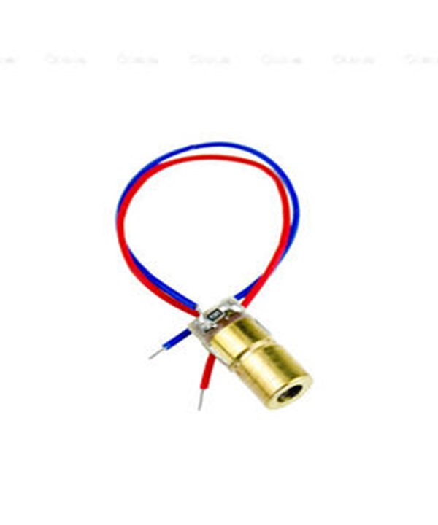
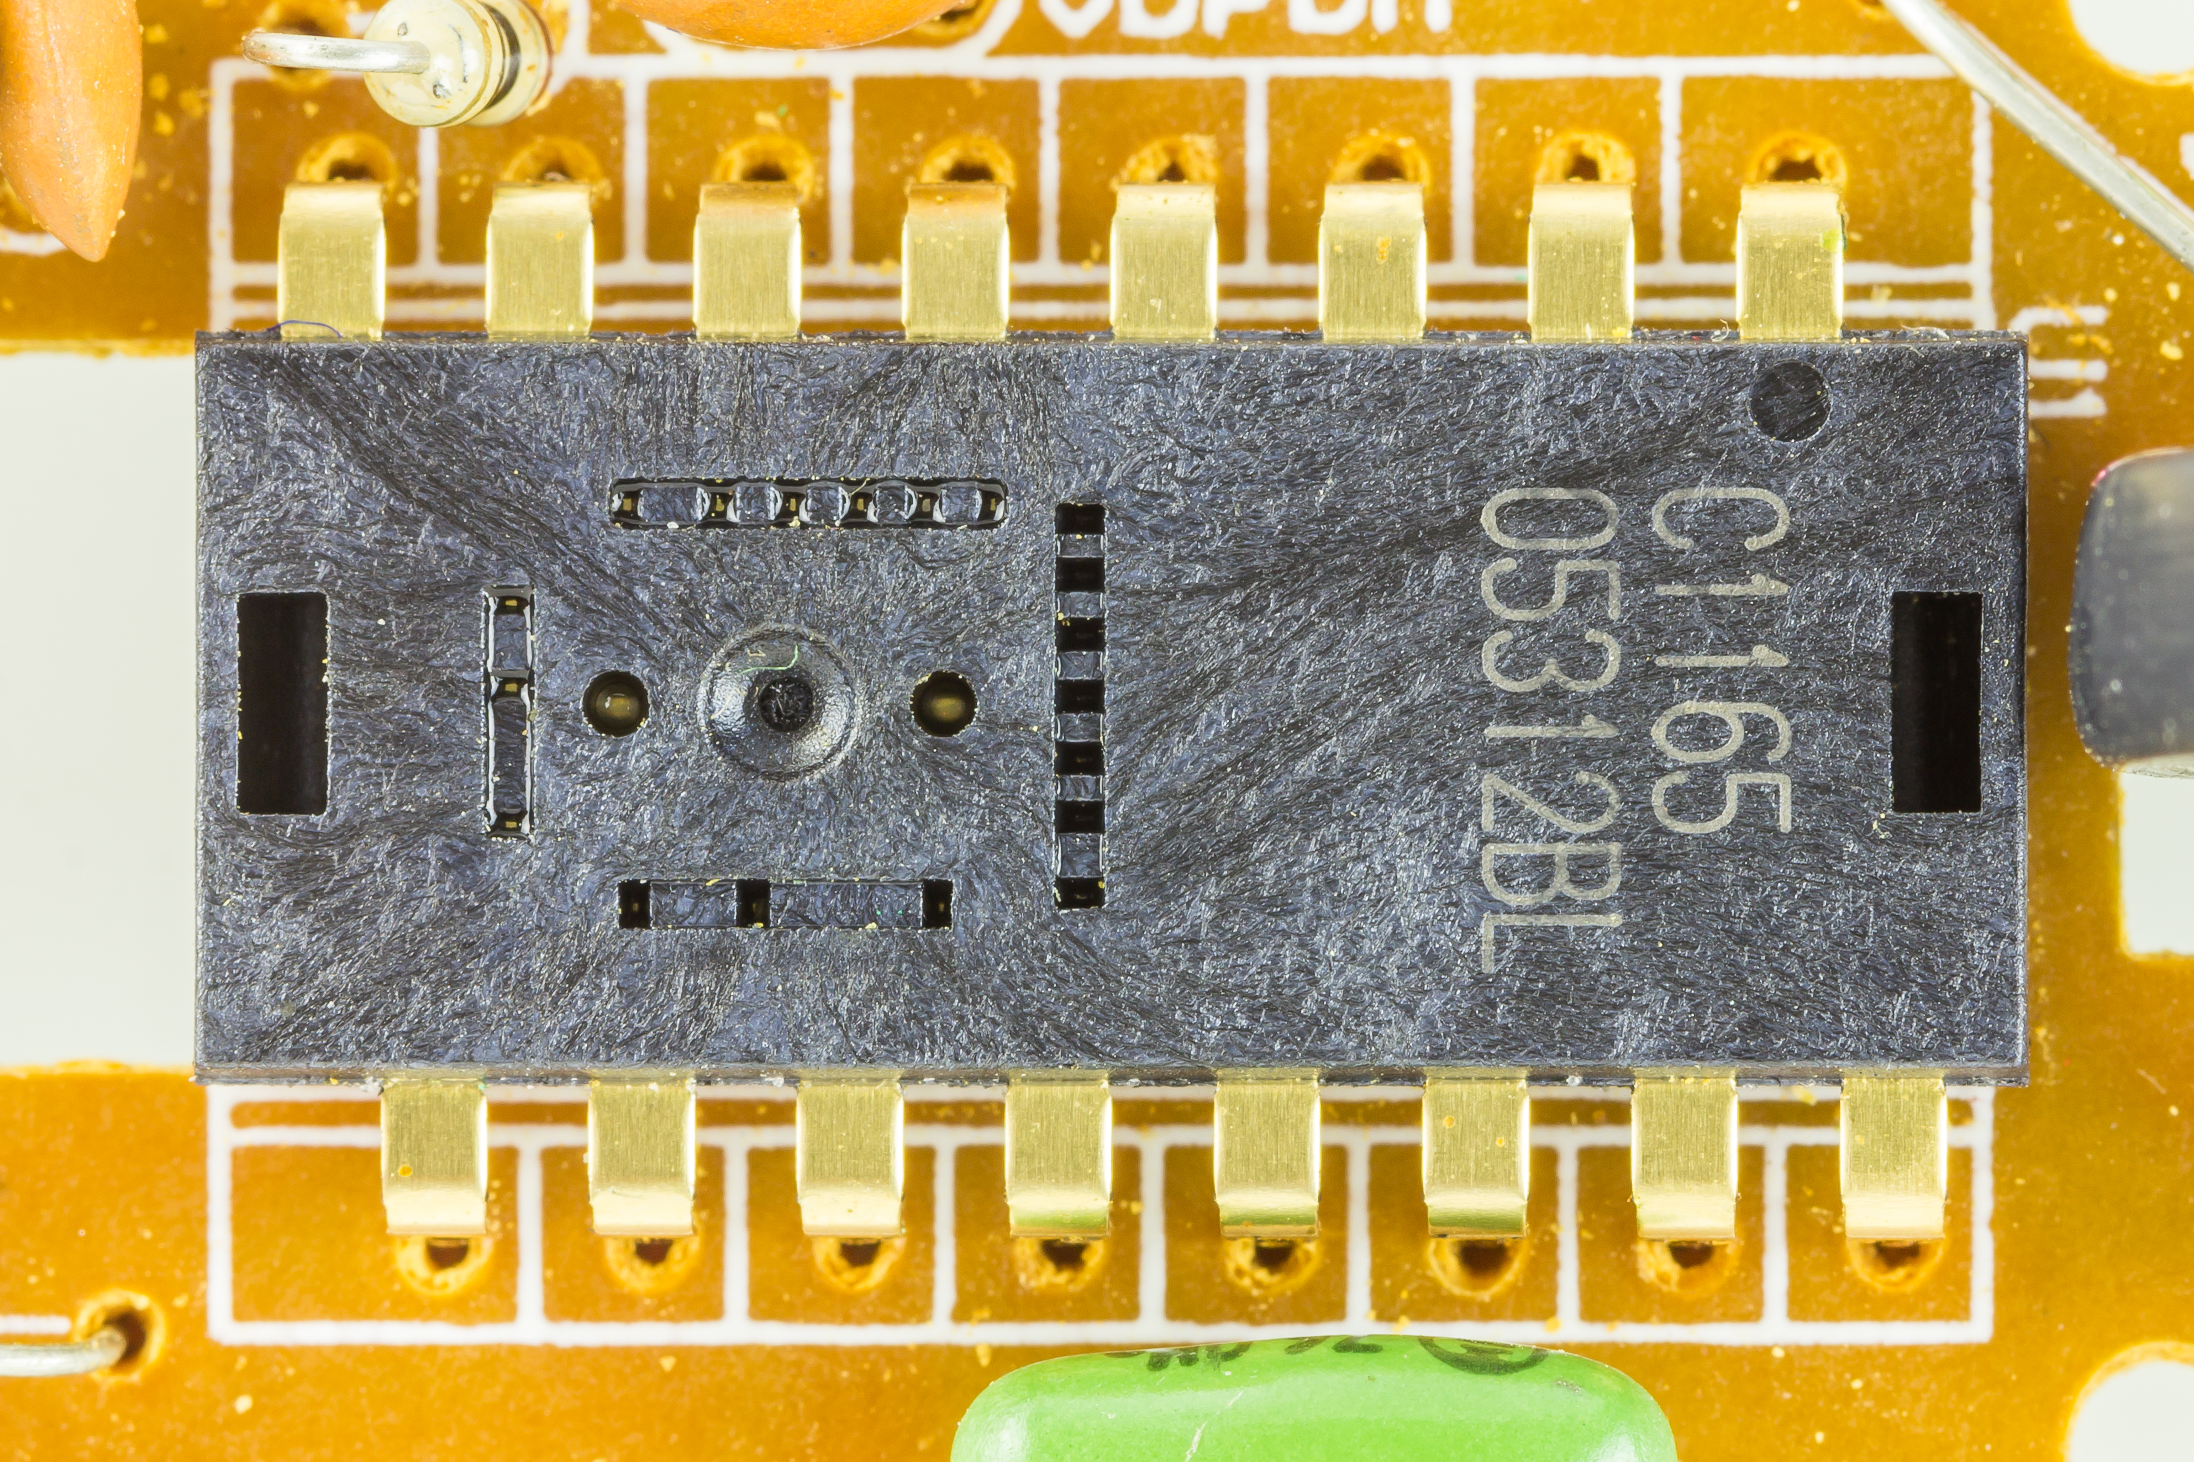
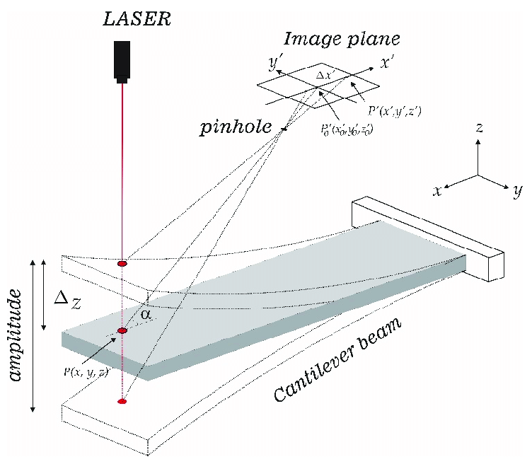

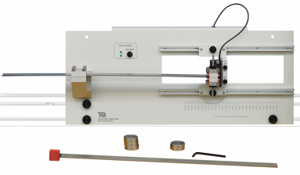
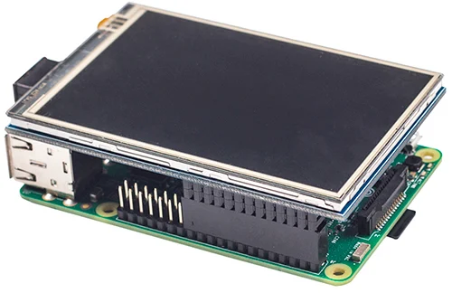


Compact Optical seismometer setup

Slide 10
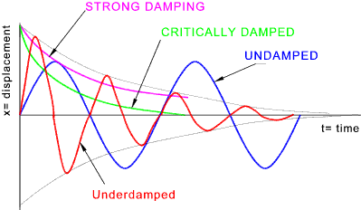


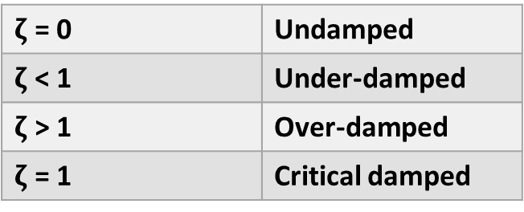
Vibration Analysis on cantilever system
General vibration equation:
$$m\ddot{x}+c\dot{x}+kx= f_{0}\sin{wt}$$
For natural vibration, $f_{0}\sin{wt}$ = 0;
Therefore, natural frequency will be : $w_{n}=\sqrt{\frac{k}{m}}$ ${rad}/{sec}$
Damping Factor($ζ$)
$ζ$ $= \frac{C}{C_{C}}$ =
$c$= Actual damping Coefficient
$c_{c}$ = Critical damping Coefficient
$ζ$ = 0 | Undamped
$ζ$ < 1 | Under-damped
$ζ$ > 1 | Over-damped
$ζ$ = 1 | Critical damped
$$\frac{c}{2\sqrt{mk}}$$

Slide 11
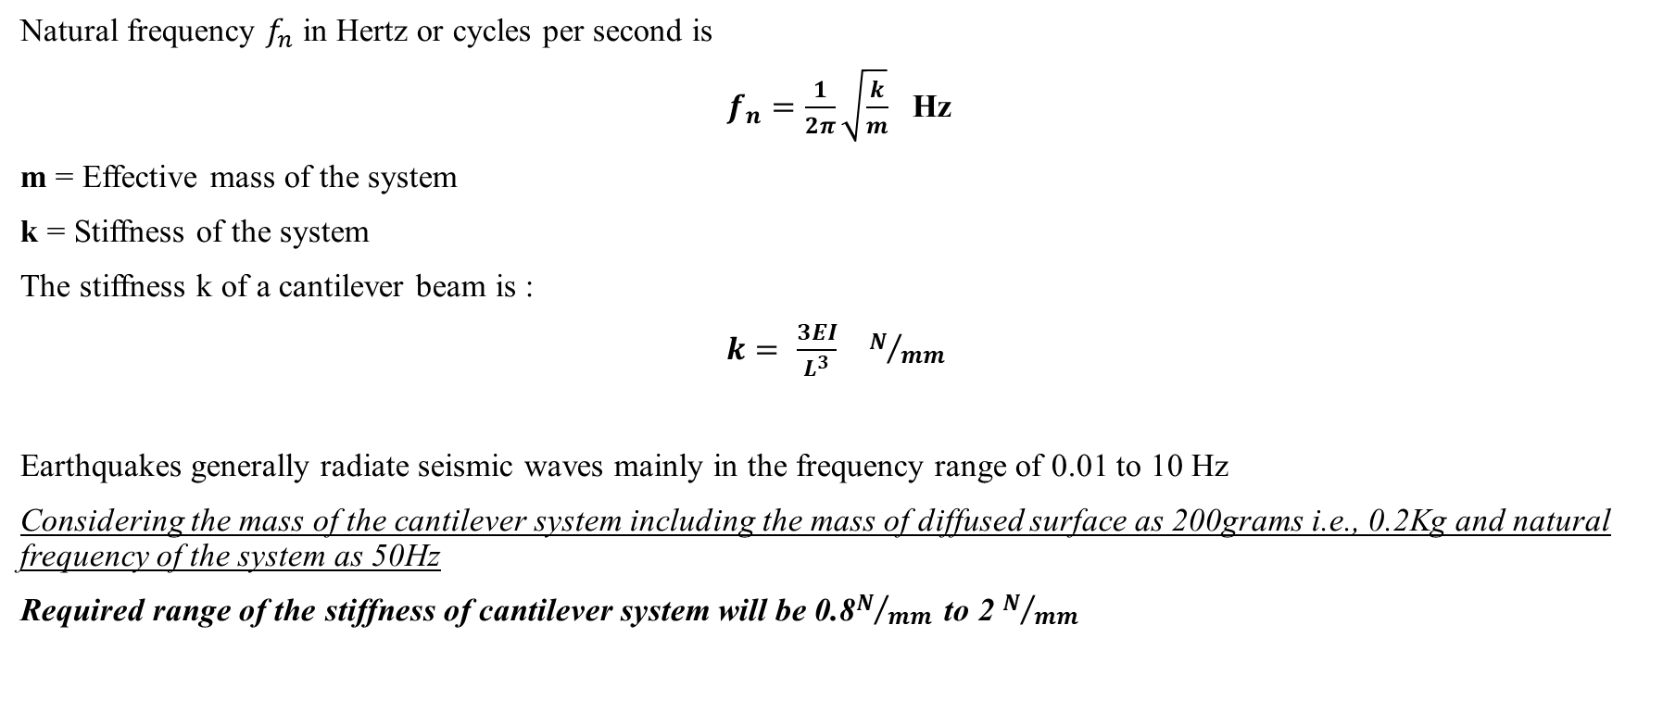
Calculation for stiffness of cantilever
Natural frequency $f_{n}$ in Hertz or cycles per second is
$f_{n}=\frac{1}{2π}\sqrt{\frac{k}{m}}$ Hz
m = Effective mass of the system
k = Stiffness of the system
The stiffness k of a cantilever beam is :
$k= \frac{3EI}{L^{3}}$ $N/{mm}$
Earthquakes generally radiate seismic waves mainly in the frequency range of 0.01 to 10 Hz
Considering the mass of the cantilever system including the mass of diffused surface as 200grams i.e., 0.2Kg and natural frequency of the system as 50Hz
Required range of the stiffness of cantilever system will be 0.8$N/{mm }$ to 2 $N/{mm }$

Slide 12
Refrences
Britannica, The Editors of Encyclopaedia. "seismograph". Encyclopedia Britannica, 29 Jan. 2020, https://www.britannica.com/science/seismograph. Accessed 28 September 2022.
Raspberry Shake upgrades to 4D in new Kickstarter https://magpi.raspberrypi.com/articles/raspberry-shake-4d
Robert E. Anthony, Adam T. Ringler, David C. Wilson, Emily Wolin; Do Low‐Cost Seismographs Perform Well Enough for Your Network? An Overview of Laboratory Tests and Field Observations of the OSOP Raspberry Shake 4D. Seismological Research Letters 2018;; 90 (1): 219–228. doi: https://doi.org/10.1785/0220180251
Moreno Oliva, Victor Ivan & Flores-Diaz, Ociel & Román-Hernández, Edwin & Campos-García, Manuel & Campos, E. & Dorrego-Portela, José & Hernández- Escobedo, Quetzalcoatl & Franco Piña, Jesus Alejandro & Perea, Alberto & Alcayde, Alfredo. (2021). Vibration Measurement Using Laser Triangulation for Applications in Wind Turbine Blades. Symmetry. 13. 1017. 10.3390/sym13061017.
F.C.L. Almeida, M.J. Brennan, F. Kroll de Lima, M.K. Iwanaga, O. Scussel, Using a geophone as an actuator to estimate the velocity of leak noise propagation in buried water pipes, Applied Acoustics, Volume 184, 2021, 108251, ISSN 0003-682X, https://doi.org/10.1016/j.apacoust.2021.108251.

Slide 13
Thank You

